Slide 1



AGE 214: Lecture 3
The PN Junction Diode
Sokoine University of Agriculture
AGE 214 - Lecture 3

Slide 2





Recap: Semiconductor Materials
Two Types of Materials
•
N-Type: Doped with Pentavalent atoms (Donor). Has excess Electrons.
•
P-Type: Doped with Trivalent atoms (Acceptor). Has excess Holes.
N-Type
P-Type
Free Electrons
Free Holes
Individually, they are just conductive blocks. But what happens if we join them physically?
Sokoine University of Agriculture
AGE 214 - Lecture 3

Slide 3

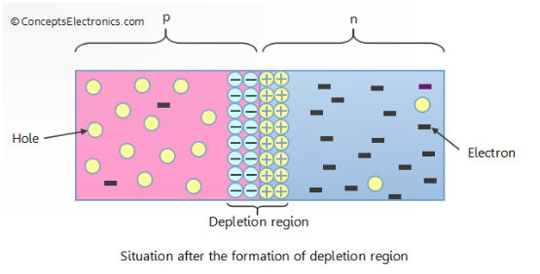
Formation of the PN Junction
The Diffusion Process
When N and P materials touch:
1.
Electrons in the N-region (high concentration) repel each other and rush toward the P-region (low concentration).
2.
Holes in the P-region rush toward the N-region.
3.
This natural movement is called Diffusion.
Sokoine University of Agriculture
AGE 214 - Lecture 3

Slide 4

The Depletion Region
Recombination & Ions
Near the junction, electrons fill holes. This Recombination eliminates free carriers.
•
N-side loses electrons → Becomes Positive (Positive Ions).
•
P-side gains electrons → Becomes Negative (Negative Ions).
This creates a zone with no free carriers called the Depletion Region.
Sokoine University of Agriculture
AGE 214 - Lecture 3

Slide 5



Barrier Potential (V0)
An Internal Electric Field
Standard Values
The positive ions on the N-side and negative ions on the P-side create an electric field.
Silicon (Si): ~ 0.7 V
This field acts as a "wall" or Barrier Potential that stops further diffusion.
Germanium (Ge): ~ 0.3 V
You must overcome this voltage to push current through the diode.
Sokoine University of Agriculture
AGE 214 - Lecture 3

Slide 6






Biasing the Diode
No Bias
Forward Bias
Reverse Bias
No external voltage applied. The diode is in equilibrium. Net current is zero.
Connecting + to P and - to N. Forces current to flow.
Connecting - to P and + to N. Blocks current flow.
Sokoine University of Agriculture
AGE 214 - Lecture 3

Slide 7
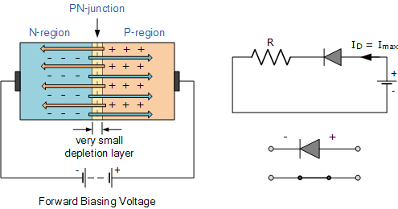
Forward Bias Operation
Overcoming the Barrier
•
Positive terminal repels holes in P-region toward junction.
•
Negative terminal repels electrons in N-region toward junction.
•
The depletion region narrows.
•
Once Vbias > 0.7V (for Si), current flows freely.
Sokoine University of Agriculture
AGE 214 - Lecture 3

Slide 8
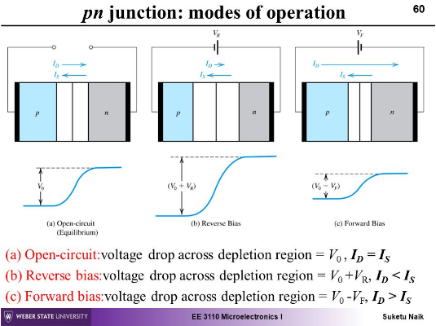
Reverse Bias Operation
Blocking the Current
•
Positive terminal attracts electrons away from junction.
•
Negative terminal attracts holes away from junction.
•
The depletion region widens.
•
Barrier potential increases. No significant current flows (only tiny leakage current).
Sokoine University of Agriculture
AGE 214 - Lecture 3

Slide 9
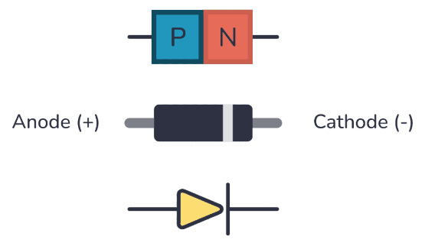
The Diode Symbol
Circuit Symbol
The arrow points in the direction of conventional current flow (Anode to Cathode).
•
Anode (A): P-Type Material (Positive).
•
Cathode (K): N-Type Material (Negative). Usually marked with a silver band on the physical component.
Sokoine University of Agriculture
AGE 214 - Lecture 3

Slide 10
Bias Summary
Feature | Forward Bias | Reverse Bias
Connections | + to P, - to N | - to P, + to N
Depletion Width | Narrows (collapses) | Widens
Resistance | Very Low (Conductor) | Very High (Insulator)
Current | Flows freely (mA to A) | Blocked (~0 A)
Sokoine University of Agriculture
AGE 214 - Lecture 3

Slide 11
Questions?
Next Lecture: Diode Characteristics & Models
Dr. Kadeghe Fue
Sokoine University of Agriculture
AGE 214 - Lecture 3

Slide 12




https://semesters.in/wp-content/uploads/2016/12/PN-junction-diode-after-depletion-region-formation.png
Source: semesters.in
https://www.electronics-tutorials.ws/wp-content/uploads/2013/08/diode7.gif?fit=495%2C259
Source: www.electronics-tutorials.ws
https://i.sstatic.net/BjCwR.png
Source: electronics.stackexchange.com
https://www.build-electronic-circuits.com/wp-content/uploads/2023/01/diode-anode-cathode-pn-1024x594.png
Source: www.build-electronic-circuits.com

